Slide 1
Do You Even Function?
Dmitry Vinnik, @DmitryVinnik
Lead Software Engineer, Salesforce

Slide 2
Goals
Functional Programming (FP):
What, How, When and Why
What are our goals?
Default FP Capabilities in Java
Custom Functional Solutions

Slide 3
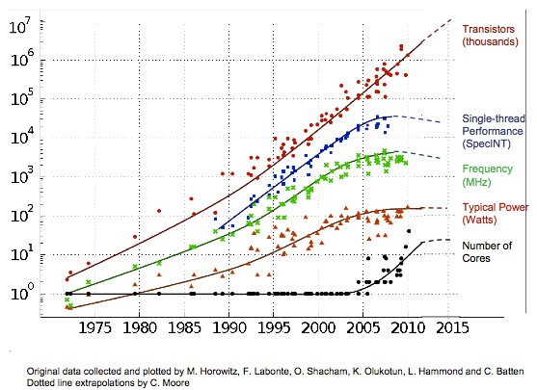
Because Concurrency
Why Functional Programming?
Motivation
Multi-Core
Microservices
CCSs
Source: The Next Platform

Slide 4
Concurrency is a Reality
Concurrency is a New Reality
Conclusion?

Slide 5
But!
What’s in it for us?
No Idling
↑ UX
Benefits
Abstraction

Slide 6
Complexities
Thread Safety
Liveness
Only good parts, right?
Performance
SDLC

Slide 7
How do we tackle it?
With Functional Programming

Slide 8
Design for
Functional Programming
Design by Contract
Lazy Evaluation
Lazy Evaluation
Temporal Coupling
No Temporal Coupling
Immutability &
Atomicity
Immutability &
Atomicity

Slide 9
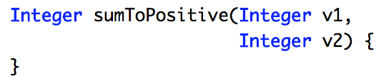
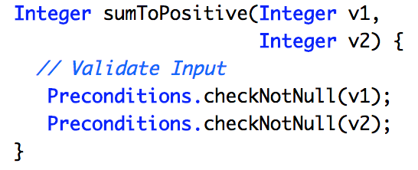
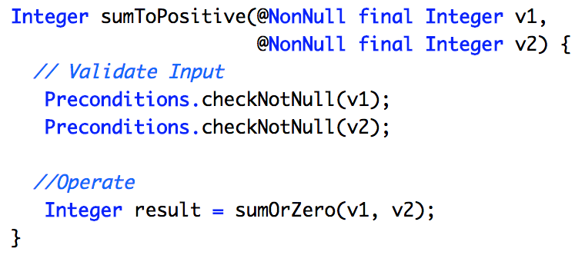
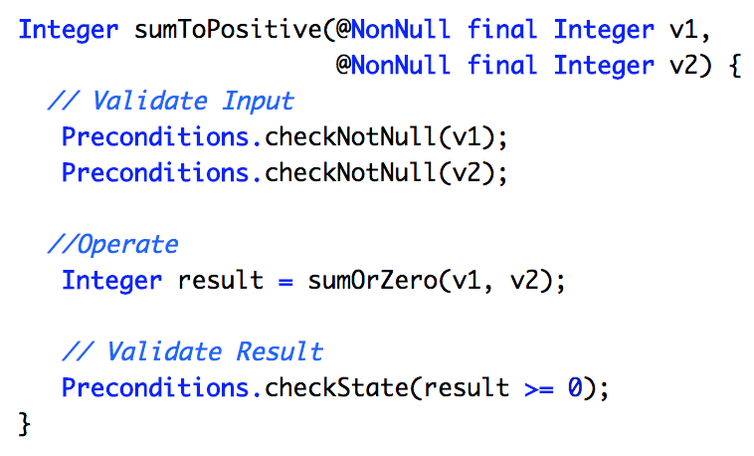
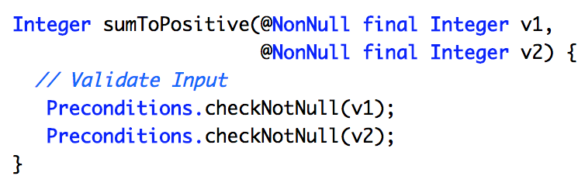
“Require No More,
Promise No Less”
Design by Contract
Design by Contract
Quote from Bertrand Meyer, “Design by Contract”

Slide 10
Design for
Functional Programming
Design by Contract
Design by Contract
Lazy Evaluation
Lazy Evaluation
Lazy Evaluation
Temporal Coupling
No Temporal Coupling
Immutability &
Atomicity
Immutability &
Atomicity

Slide 11
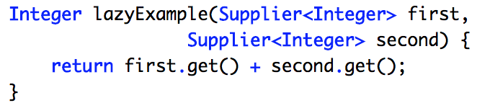
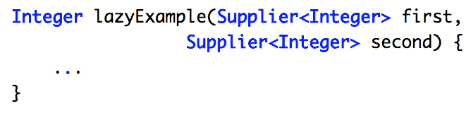
Lazy Evaluation
"Lazy Evaluation is like Filing Taxes"
Lazy Evaluation
Quote from Venkat Subramaniam,
“Let’s Get Lazy”

Slide 12
Design for
Functional Programming
Design by Contract
Design by Contract
Lazy Evaluation
Lazy Evaluation
Lazy Evaluation
Lazy Evaluation
Temporal Coupling
No Temporal Coupling
No Temporal Coupling
Immutability &
Atomicity
Immutability &
Atomicity

Slide 13
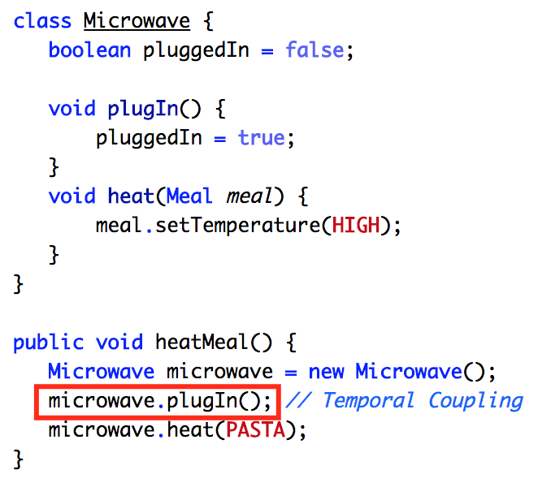
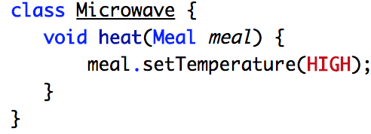
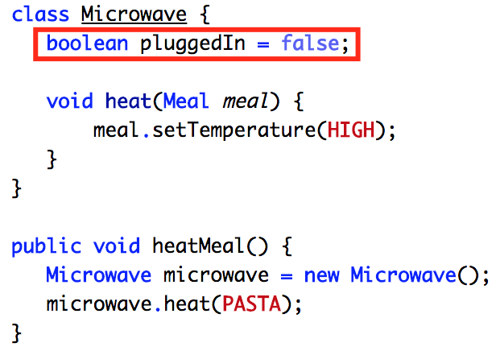
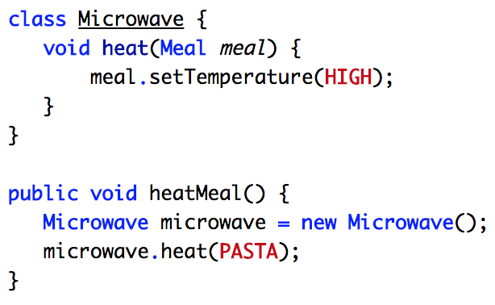
Temporal Coupling
Temporal Coupling
“When time & order really matter”
Notes:
Good example is http clienta

Slide 14
Design for
Functional Programming
Design by Contract
Design by Contract
Lazy Evaluation
Lazy Evaluation
Lazy Evaluation
Lazy Evaluation
Temporal Coupling
No Temporal Coupling
No Temporal Coupling
No Temporal Coupling
Immutability &
Atomicity
Immutability &
Atomicity
Immutability &
Atomicity

Slide 15
Functional Programming
In Practice
How would we write Functional Code?

Slide 16
Let’s consider two styles:
Imperative and Declarative

Slide 17
Assume a Use Case:
Searching for a word
in a phrase

Slide 18
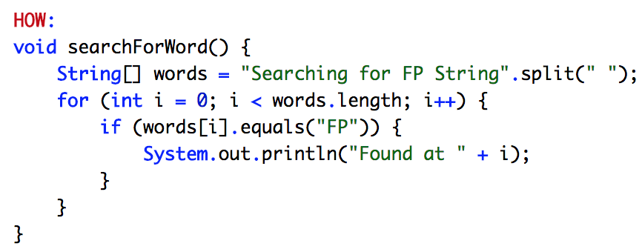
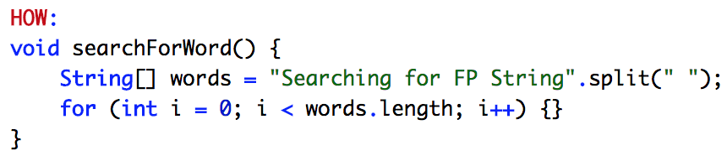
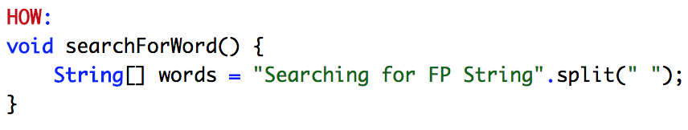
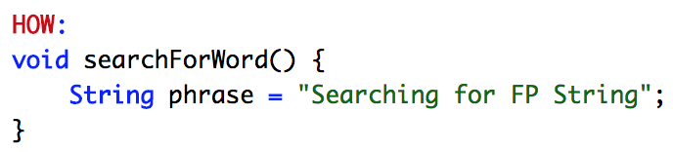
Imperative Style
Imperative vs. Declarative
How vs. What

Slide 19
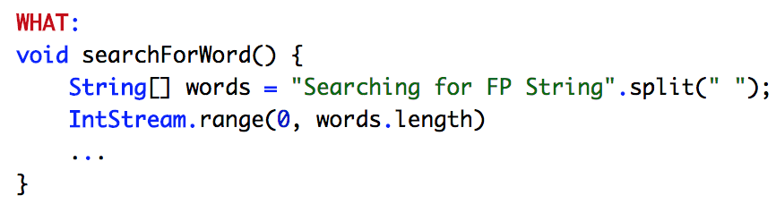
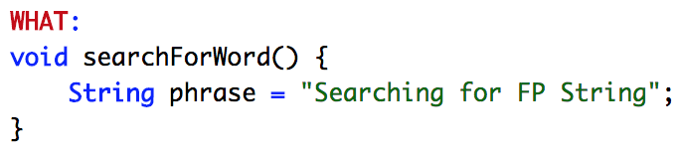
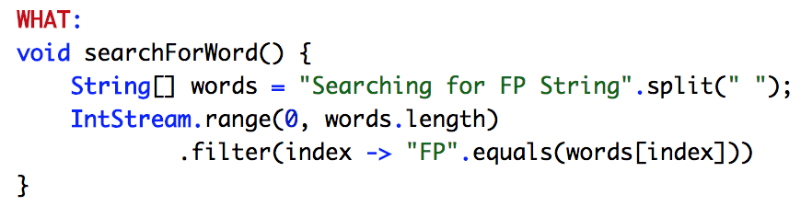
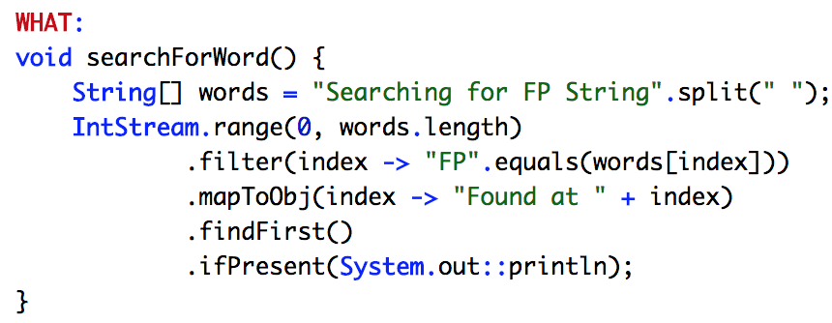
Declarative Style
Imperative vs. Declarative
How vs. What

Slide 20
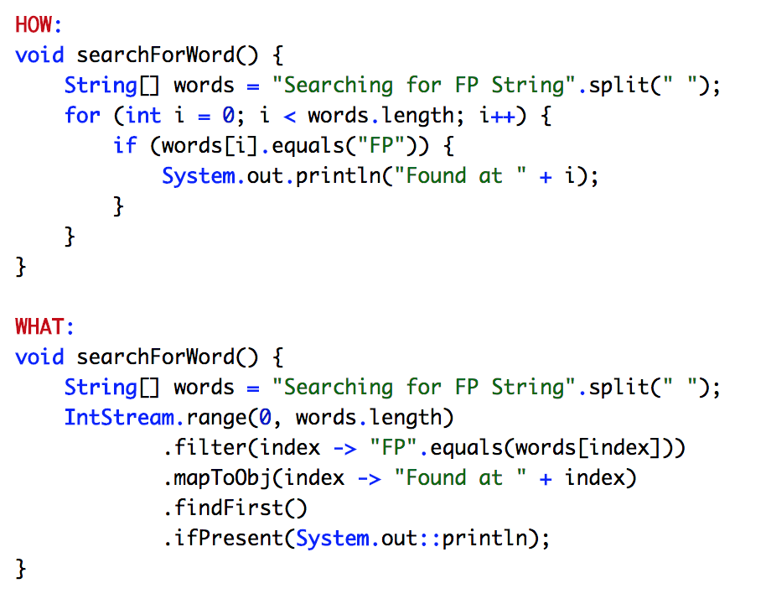
Styles Side by Side
Imperative vs. Declarative
How vs. What

Slide 21
Benefits of
Declarative Style
↓ Complexity
↓ Verbosity
↓ Verbosity
↑ Readability
↑ Readability

Slide 22
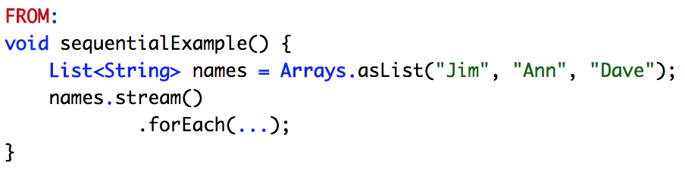
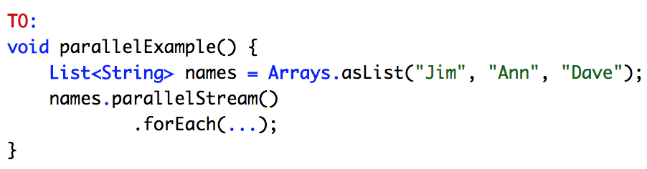
Decreased Complexity
Decreased Complexity

Slide 23
Benefits of
Declarative Style
↓ Complexity
↓ Complexity
↓ Verbosity
↓ Verbosity
↓ Verbosity
↑ Readability
↑ Readability
Notes:
Especially Complexity of Concurrency

Slide 24
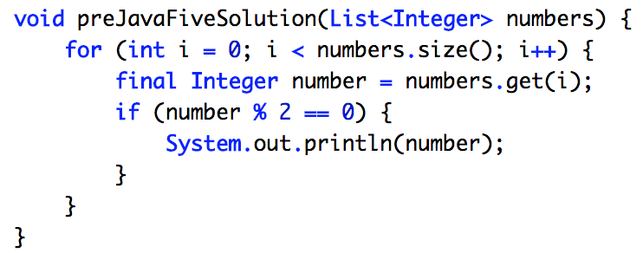
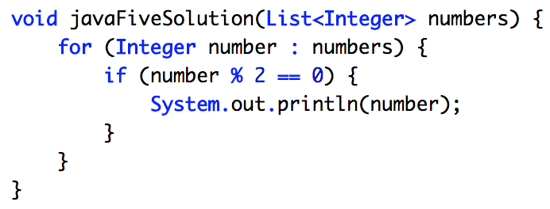
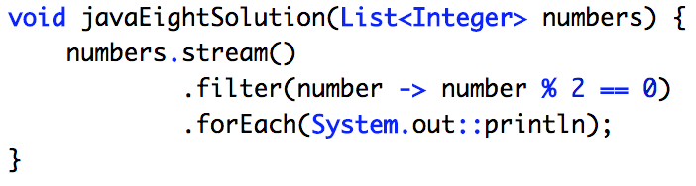
Decreased Verbosity
Decreased Verbosity

Slide 25
Benefits of
Declarative Style
↓ Complexity
↓ Complexity
↓ Verbosity
↓ Verbosity
↓ Verbosity
↓ Verbosity
↑ Readability
↑ Readability
↑ Readability

Slide 26
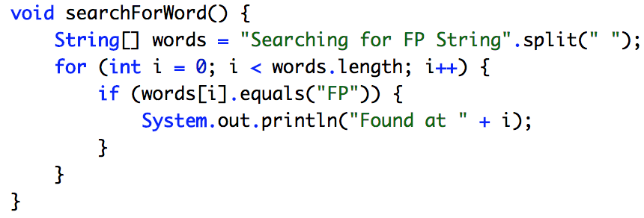
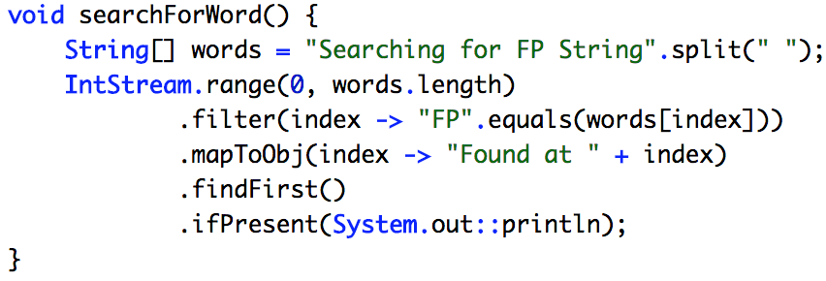
Increased Readability
Increased Readability

Slide 27
Conclusion?
Changing Paradigms

Slide 28
Changing Paradigms
Changing Paradigms
FP
Declarative Programming
Imperative Programming

Slide 29
Let’s see some FP in Java
Starting from the Base
Enough Theory!
Stream
Optional

Slide 30
How do we get Functional with Collections?
What do we do the most?
Dealing with Data
Dealing with Collections
Pipeline of Functions
Lazily Evaluated
Streams
Data Mutation
Data Transformation

Slide 31
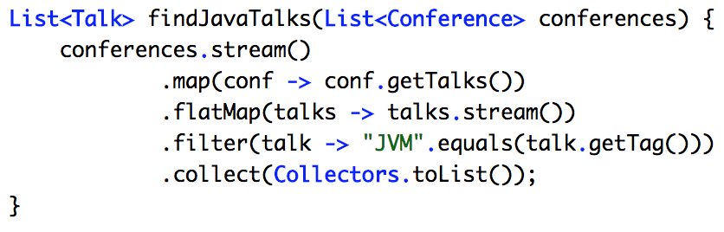
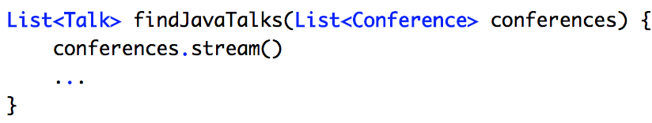
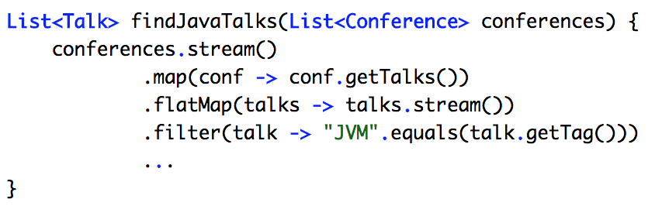
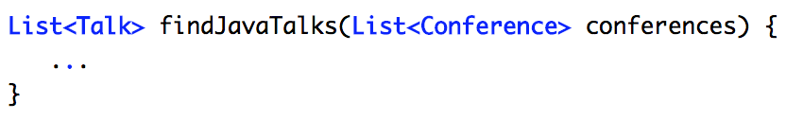
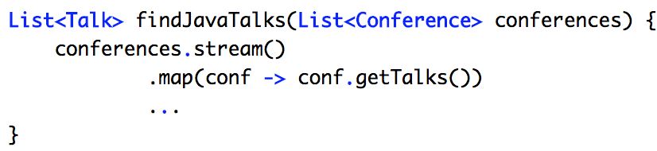
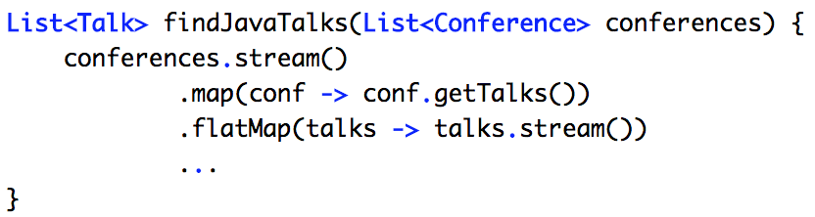
Streams
Streams

Slide 32
That’s all great
But...
What if I want to find something?
Optional is the answer

Slide 33
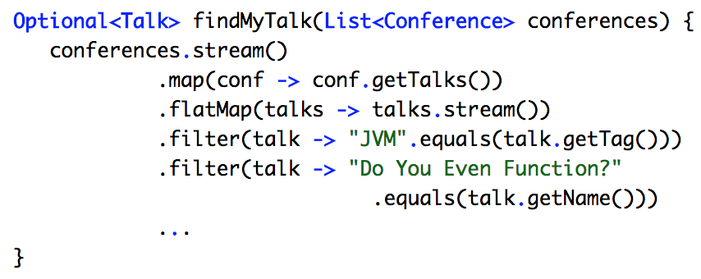
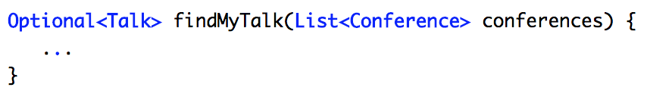
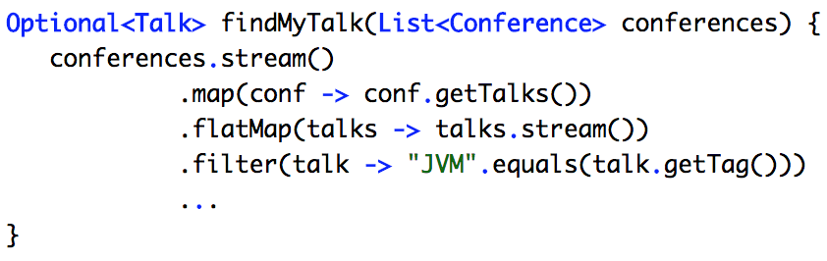
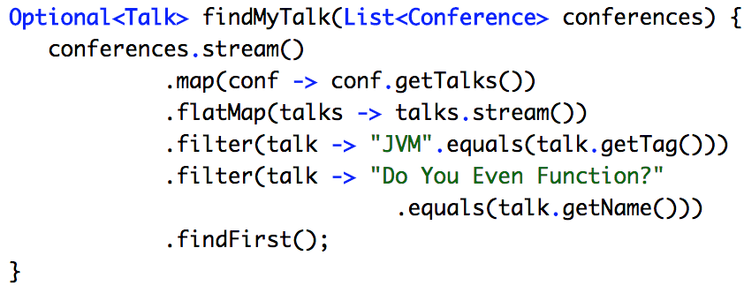
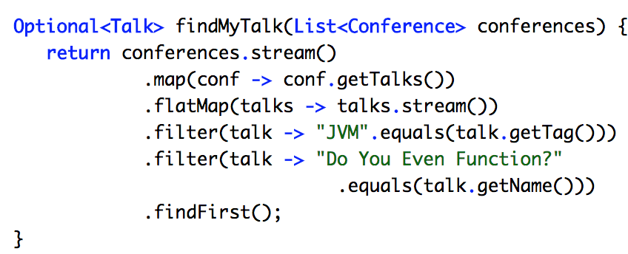
Finding Optional Talk
Together

Slide 34
Optional
Value State
Null Check Supplement
Data Mutation
Data Transformation

Slide 35
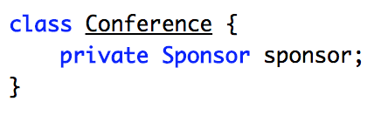
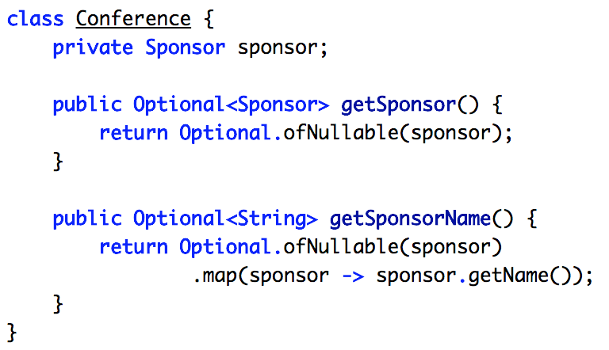
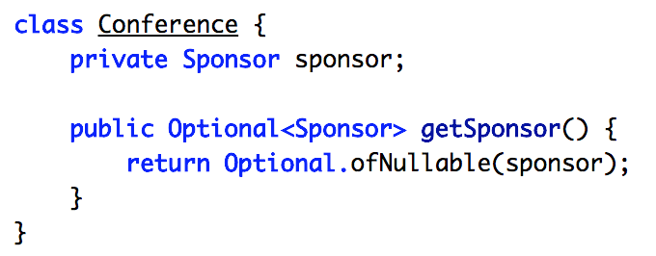
Optional
Optional

Slide 36
But it still seems verbose
Looks promising
Method Reference
to the Rescue!

Slide 37
What is it good for?
“There are only two hard things in Computer Science:
Cache Invalidation and
naming things”
Quote from Phil Karlton

Slide 38
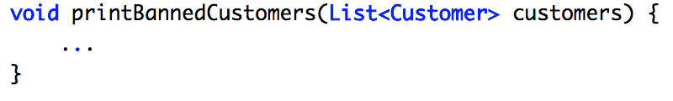
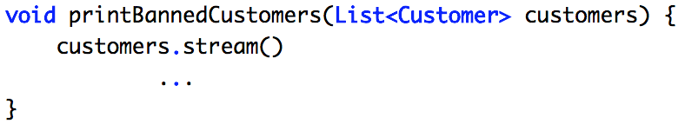
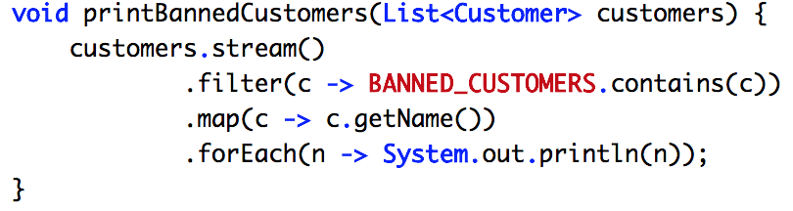
Method Reference: Before

Slide 39
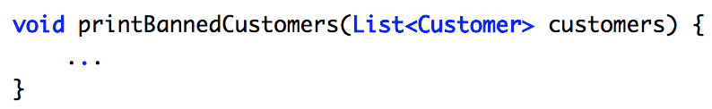
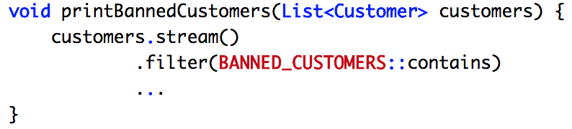
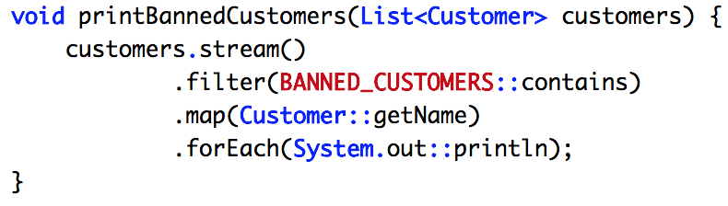
Method Reference: After
Why do we need temporary variables?

Slide 40
Method Reference

Slide 41
Looks good
But what about
Functional Programming and Debugging

Slide 42
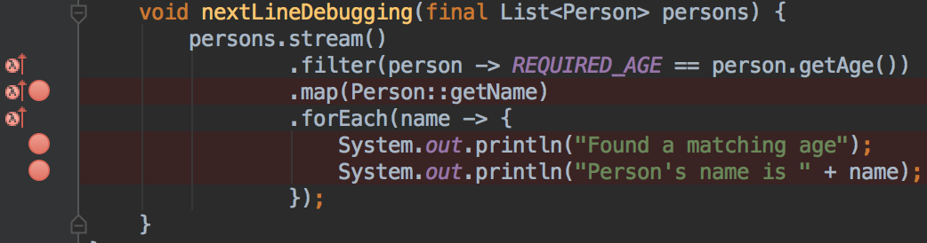
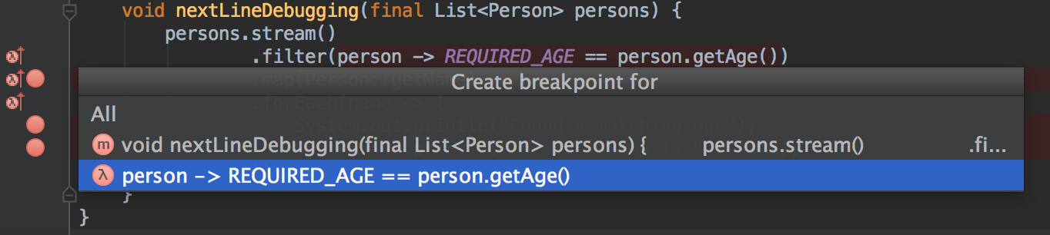
One Line per Statement Style

Slide 43
Now we have all the tools
Let’s Get Functional

Slide 44
High Order Functions
Functions
as First Class Entities
Functions as Input
Functions as Output

Slide 45
Why High Order Functions?
↑ Abstraction
DRY by Design
↓ Complexity
↑ Readability

Slide 46
Types of Functions
Are all Functions equal?
No!
Pure Functions
Impure Functions

Slide 47
Pure Functions
Immutable
Side Effects
Same Input
Same Output

Slide 48





Pure Functions

Slide 49
Let’s see Functions in Action
Let’s see Functions in Java

Slide 50
Functional Interfaces
Single Abstract Method
Helper Annotation
Static Methods
Default Methods

Slide 51


Functional Interfaces

Slide 52
High Order Functions
Out-of-the-Box
Function<T, R>
Predicate<T>
Predicate<T>
Supplier<T>
Consumer<T>
Supplier<T>
Consumer<T>
Notes:
High Order Function
Javadoc
Function<T, R>
Represents a function that accepts one argument and produces a result
Predicate<T>
Represents a predicate (boolean-valued function) of one argument
Consumer<T>
Represents an operation that accepts a single input argument and returns no result
Supplier<T>
Represents a supplier of results
...
...
High Order Function
Javadoc
Function<T, R>
Represents a function that accepts one argument and produces a result
Predicate<T>
Represents a predicate (boolean-valued function) of one argument
Consumer<T>
Represents an operation that accepts a single input argument and returns no result
Supplier<T>
Represents a supplier of results
...
...

Slide 53




Function<T, R>
One Input
One Output

Slide 54





Function<T, R>
Capabilities:
Functions Composition

Slide 55
High Order Functions
Out-of-the-Box
Function<T, R>
Function<T, R>
Predicate<T>
Predicate<T>
Predicate<T>
Supplier<T>
Consumer<T>
Supplier<T>
Consumer<T>
Notes:
High Order Function
Javadoc
Function<T, R>
Represents a function that accepts one argument and produces a result
Predicate<T>
Represents a predicate (boolean-valued function) of one argument
Consumer<T>
Represents an operation that accepts a single input argument and returns no result
Supplier<T>
Represents a supplier of results
...
...
High Order Function
Javadoc
Function<T, R>
Represents a function that accepts one argument and produces a result
Predicate<T>
Represents a predicate (boolean-valued function) of one argument
Consumer<T>
Represents an operation that accepts a single input argument and returns no result
Supplier<T>
Represents a supplier of results
...
...

Slide 56




Predicate<T>
Predicate<T>
One Input
Boolean Output

Slide 57





Predicate<T>
Capabilities:
Logical Operators

Slide 58
High Order Functions
Out-of-the-Box
Function<T, R>
Function<T, R>
Predicate<T>
Predicate<T>
Predicate<T>
Predicate<T>
Supplier<T>
Supplier<T>
Consumer<T>
Supplier<T>
Consumer<T>
Consumer<T>
Notes:
High Order Function
Javadoc
Function<T, R>
Represents a function that accepts one argument and produces a result
Predicate<T>
Represents a predicate (boolean-valued function) of one argument
Consumer<T>
Represents an operation that accepts a single input argument and returns no result
Supplier<T>
Represents a supplier of results
...
...
High Order Function
Javadoc
Function<T, R>
Represents a function that accepts one argument and produces a result
Predicate<T>
Represents a predicate (boolean-valued function) of one argument
Consumer<T>
Represents an operation that accepts a single input argument and returns no result
Supplier<T>
Represents a supplier of results
...
...

Slide 59



Consumer<T>
Predicate<T>
One Input
No Output

Slide 60




Consumer<T>
Capabilities:
Functions Chaining

Slide 61
High Order Functions
Out-of-the-Box
Function<T, R>
Function<T, R>
Predicate<T>
Predicate<T>
Predicate<T>
Predicate<T>
Supplier<T>
Supplier<T>
Supplier<T>
Consumer<T>
Supplier<T>
Consumer<T>
Consumer<T>
Consumer<T>
Notes:
High Order Function
Javadoc
Function<T, R>
Represents a function that accepts one argument and produces a result
Predicate<T>
Represents a predicate (boolean-valued function) of one argument
Consumer<T>
Represents an operation that accepts a single input argument and returns no result
Supplier<T>
Represents a supplier of results
...
...
High Order Function
Javadoc
Function<T, R>
Represents a function that accepts one argument and produces a result
Predicate<T>
Represents a predicate (boolean-valued function) of one argument
Consumer<T>
Represents an operation that accepts a single input argument and returns no result
Supplier<T>
Represents a supplier of results
...
...

Slide 62



Supplier<T>
Predicate<T>
No Input
One Output

Slide 63



Supplier<T>
Capabilities:
Wrapped Execution

Slide 64
High Order Functions
Summary
Function<T, R>
Data
Transformation
Predicate<T>
Data Filtering
Consumer<T>
Data Processing
Supplier<T>
Process Execution

Slide 65
But what about custom Functional Use Cases?
Out-of-the-Box is nice

Slide 66





Let’s Build Custom Functional Interface

Slide 67
What about some Common Use Cases?
Error Handling
Error Passing
Error Passing
Common Use Cases
Multi-Dimensional
Structures
Multi-Dimensional
Structures

Slide 68






FP: Error Handling

Slide 69
Error Handling
Error Passing
Error Handling
Error Passing
Error Passing
Common Use Cases
Multi-Dimensional
Structures
Multi-Dimensional
Structures

Slide 70


FP: Error Passing

Slide 71
Error Handling
Error Passing
Error Handling
Error Passing
Error Passing
Error Passing
Common Use Cases
Multi-Dimensional
Structures
Multi-Dimensional
Structures
Multi-Dimensional
Structures

Slide 72
Multi-Dimensional Structures: jOOQ/jOOL
Function 1...16
Consumer 1...16
Tuple 1...16
Sequences

Slide 73
Functional Programming looks great!
But is there anything to be avoided?

Slide 74
Functional Programming:
Antipatterns
Overly DRY
Impure
Functions
Early Optimization

Slide 75
Call For Action
Embrace FP
Review Your Application
Continue Learning

Slide 76
Q/A

Slide 77
Contact Speaker
Twitter: @DmitryVinnik
LinkedIn: in/dmitry-vinnik/
Email: dmitry@dvinnik.com

